Slide 1
Physical and Chemical Properties and Changes

Slide 2
Property
Is a description of an object
If struck by lighting, the tree could catch FIRE (BURN)
The tree is GREEN
The tree is TALL

Slide 3
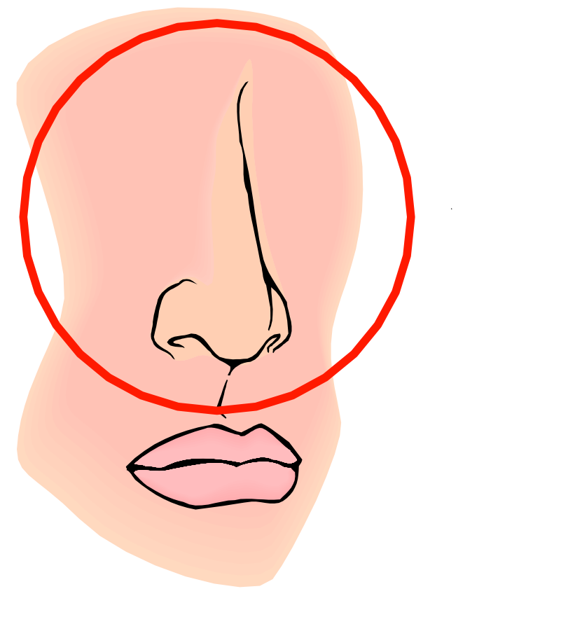
Physical Properties
five
Are determined by the use of the .
They are a of an object.
senses
description

Slide 4
Examples of Physical Properties
Color
Smell
Taste
Hardness
State of Matter
Boiling, Freezing, or Melting Point

Slide 5
Examples of Physical Properties
Density
Mass
Volume
Malleability (the ability to be molded)
Solubility (the ability to be dissolved)

Slide 6
Chemical Properties
Are determined by a substance’s ability to with other substances.
react

Slide 7
Examples of Chemical Properties
The ability to react with
-
-
-
-
The ability to react with
The ability to catch fire ( )
air
rust
tarnish
corrode
rot
water/acids
flammability

Slide 8
Quiz Yourself…

Slide 9
#1. Physical or Chemical Property?
Ability of gun powder and fire to explode.
Chemical Property

Slide 10
#2. Physical or Chemical Property?
The color of a sunset.
Physical Property

Slide 11
#3. Physical or Chemical Property?
The ability of a nail to rust.
Chemical Property

Slide 12
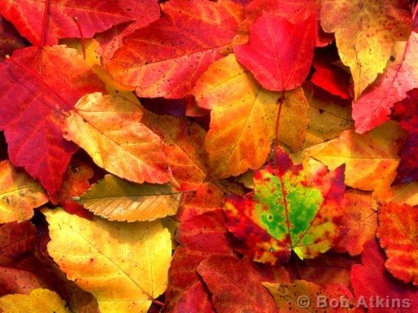
#4. Physical or Chemical Property?
The shape of a leaf.
Physical Property

Slide 13
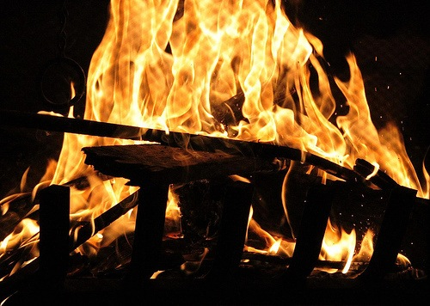
#5. Physical or Chemical Property?
The ability of wood to burn.
Chemical Property

Slide 14
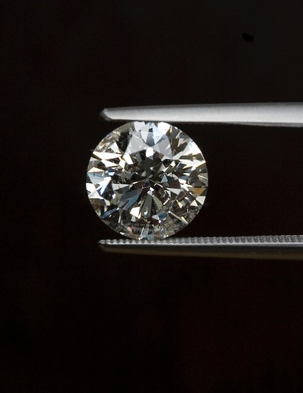
#6. Physical or Chemical Property?
The hardness of a diamond.
Physical Property

Slide 15
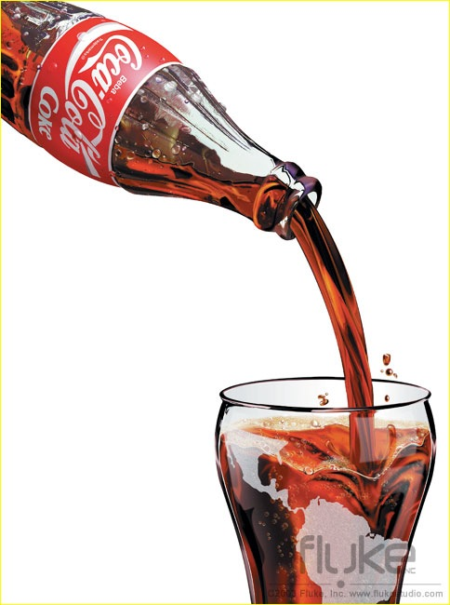
#7. Physical or Chemical Property?
The volume of your coke.
Physical Property

Slide 16
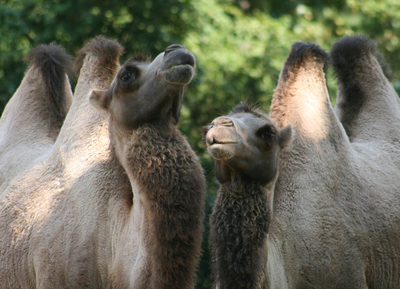
#8. Physical or Chemical Property?
The mass of two camels.
Physical Property

Slide 17
Physical Changes
a change that occurs
changing the of the substance.
____ new substances are formed.
without
identity
No

Slide 18
Examples of Physical Changes
Change in size, shape, or color
Pencil shavings
Torn Paper
Crushed ice
Sugar dissolved in water
Painting a wall

Slide 19
Chemical Changes
a change that occurs that the of a substance to change; something is formed.
New substances with properties are formed
causes
identity
new
new

Slide 20
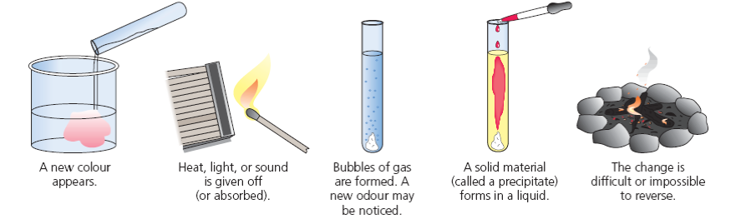
Evidence of Chemical Change
color
New ________appears
Bubbles or ________
Precipitate forms (____ material)
_____ is produced
______ is produced
______ is given off
Heat
fizzing
Light
solid
Sound
reverse
Difficult or impossible to __________

Slide 21
Reactions with Acid
Vinegar + baking soda = release of Carbon Dioxide Gas

Slide 22
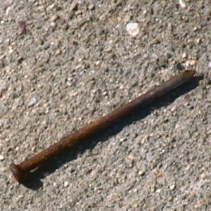
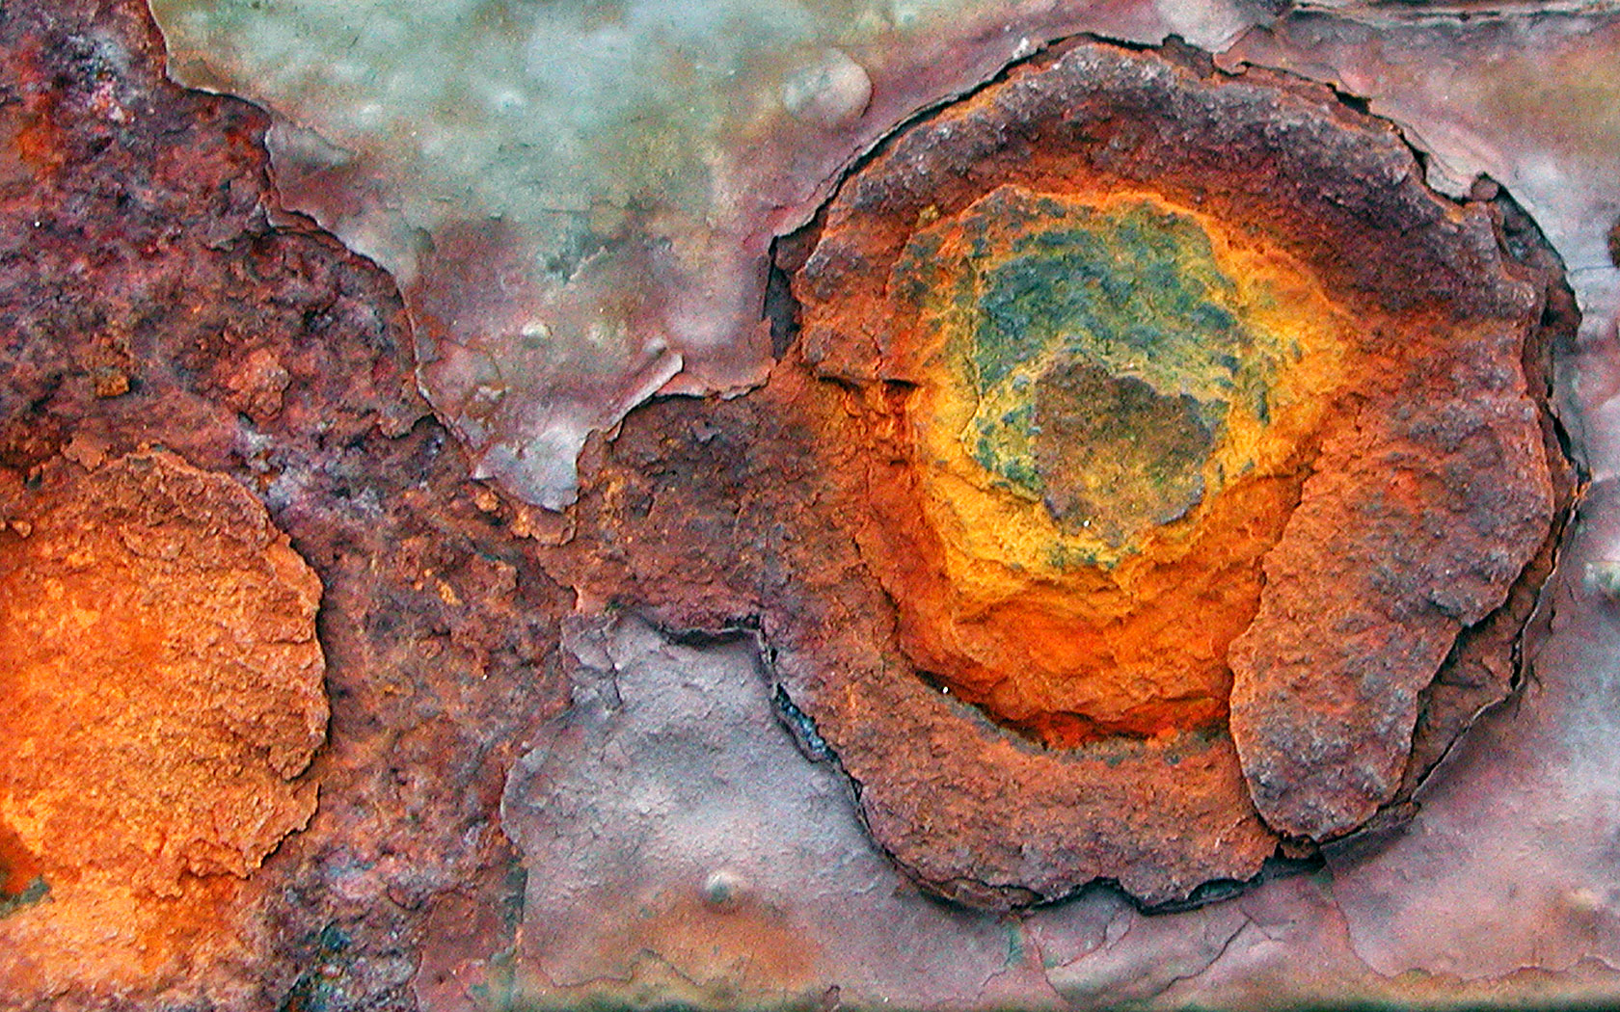
Reactions with Oxygen
OXIDATION
Iron + Oxygen = rust

Slide 23
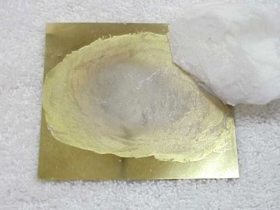
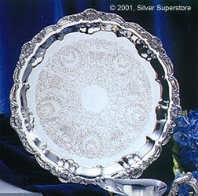
Reactions with Electricity
Silver Plating

Slide 24
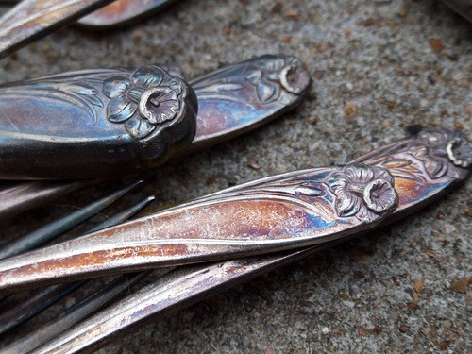
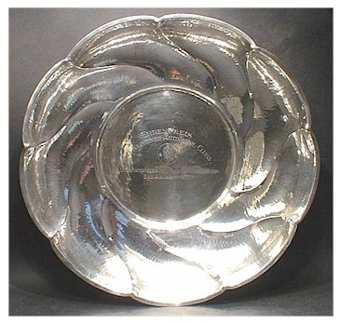
Reactions between Substances
Sodium + chloride = salt
Silver + sulfer in the air = tarnish

Slide 25
Other Examples
Wood burning
Metal rusting
Food digesting
Gasoline burning
Cake baking

Slide 26
Quiz Yourself…

Slide 27
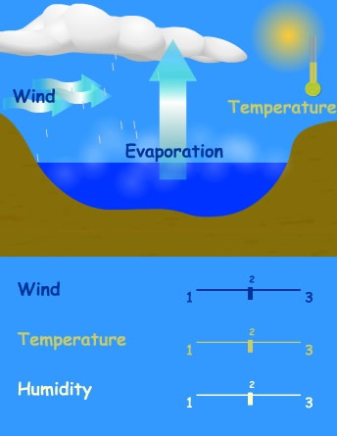
#1. Physical or Chemical Change?
Water evaporates from the ocean.
Physical Change

Slide 28
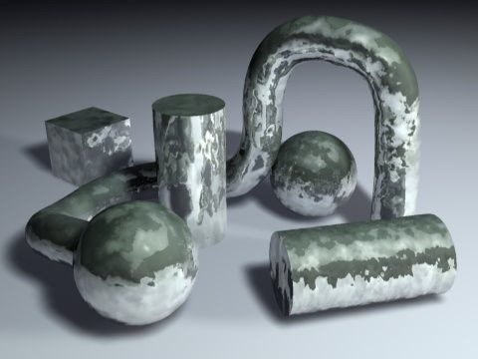
#2. Physical or Chemical Change?
The yolk of an egg, which contains sulfur, causes tarnish to form on silver.
Chemical Change

Slide 29
# 3. Physical or Chemical Change?
The ice on a lake melts to become water in the lake.
Physical Change

Slide 30
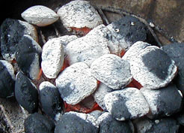
#4. Physical or Chemical Change?
Charcoal in a fire turns to ash after several hours.
Chemical Change

Slide 31
#5. Physical or Chemical Change?
A pencil is sharpened in a pencil sharpener, leaving behind shavings.
Physical Change

Slide 32
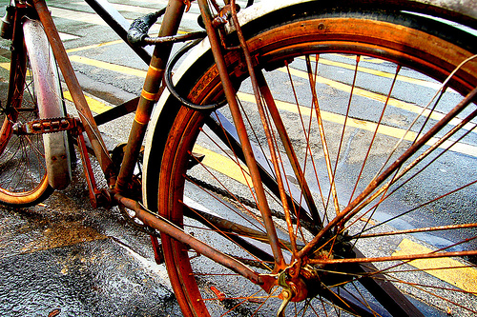
#6. Physical or Chemical Change?
A bicycle rusts when left in the rain.
Chemical Change

Slide 33
#7. Physical or Chemical Change?
A shirt is accidentally torn in the washing machine.
Physical Change

Slide 34
#8. Physical or Chemical Change?
A log is split in two by an axe.
Physical Change

Slide 35
Use this link below and watch the video about Physical and Chemical Properties.
http://youtu.be/X328AWaJXvI

